Slide 1
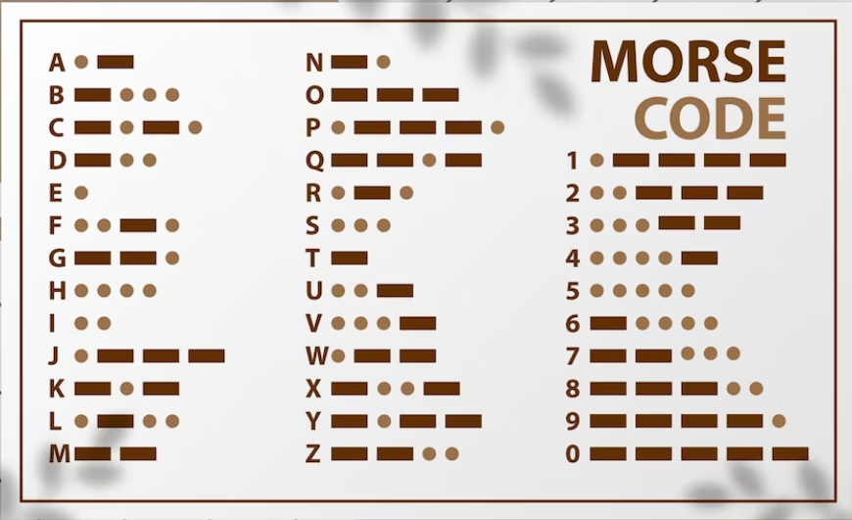
Comparative Analysis of Detection of Text from Morse Code in Images using CNN
Presented By
Shaik Johny Basha
Duggineni Veeraiah
Karavadi Raviteja
Mangam Surya Prakash
Kasturi Karthik

Slide 2
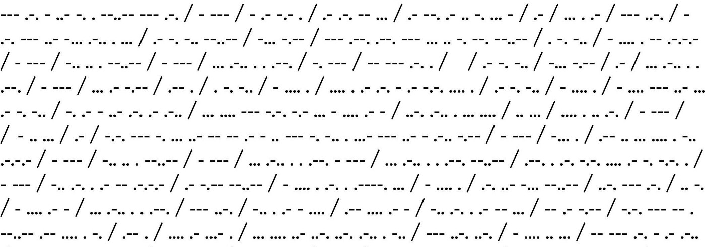
Introduction
Detection of text from images of morse code is a complex process and there is no active research in this area. As these are images, different people can have different styles of writing.
Even though we have these problems, we intend to built a machine learning model which will extract the morse code present in the input image and convert that morse code to the English language with the help of convolutional neural networks with better accuracy.

Slide 3

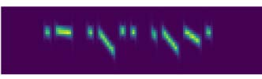
Motivation
Base Paper : https://ieeexplore.ieee.org/document/9051374
In this paper, the deep learning method is introduced to construct a neural network model as the Morse decoding system, which is a novel approach in the relevant field.
Here, the time frequency signals i.e : audio signals are taken as input to the model, CNN’s are used to extract the important features from the input, BLSTM network used to label feature frames from CNN. Then the RNN’s are used for the sequential based character recognition.

Slide 4
Objectives
We are building a dataset, which consists of 200 images of each character present in morse code, as there are 36 characters we intend to create a dataset consisting of 7,200 images.
Then we have given all the input data to machine learning model.
We have implemented CNN architectures i.e., LeNet, AlexNet.
We trained the model with multiple epochs i.e : at 5 epochs, 10 epochs, 15 epochs, 20 epochs.

Slide 5
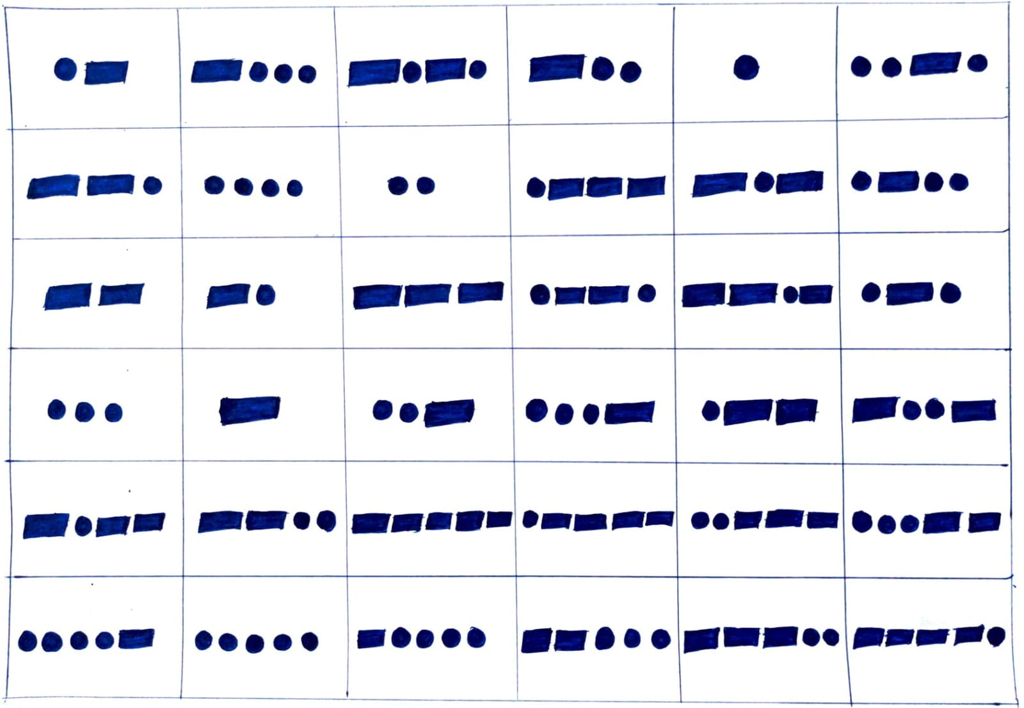
Dataset Creation

Slide 6
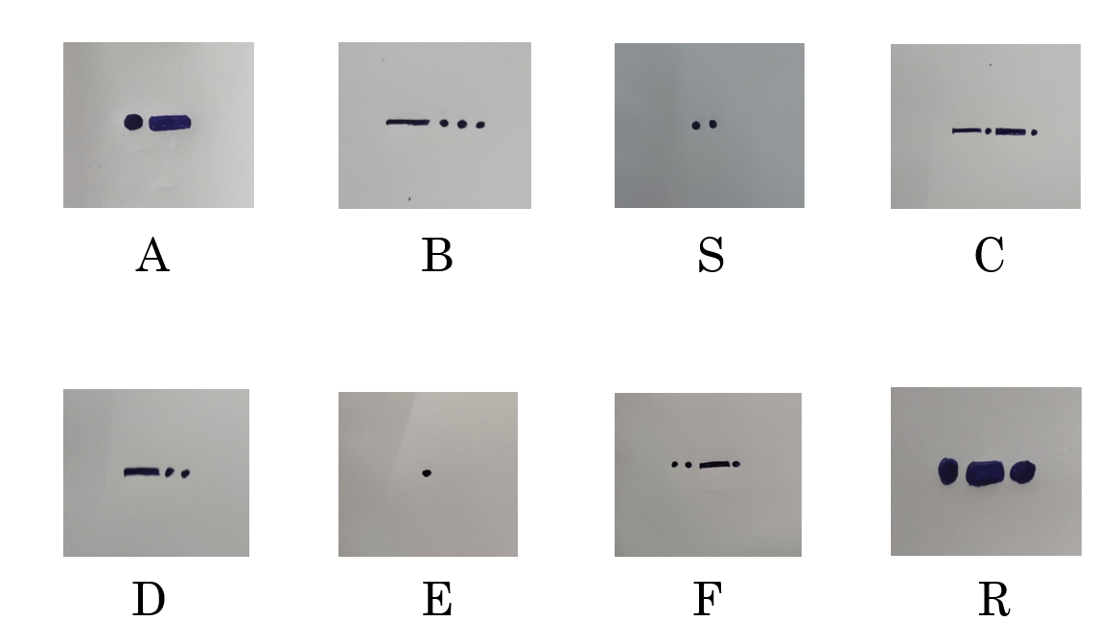

Slide 7

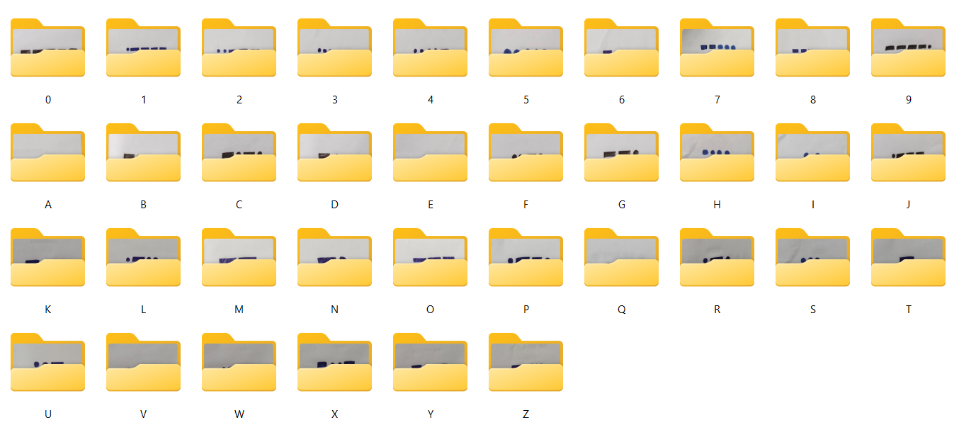

Slide 8
LitLiterature Surveyeratururve
S.No | Journal | Author | Title | Description
1. | ICICAS - 2019 | Weihao Li, Keren Wang | Research on Automatic Decoding of Morse Code Based on Deep Learning | Advantages: The model will detect the morse code present in the audio and then convert it into English text with 90% accuracy Limitations: We can only give frequency signals(audio) as input and moreover many times the high pitch signals cannot be predicted effectively.
2. | ICCCNT - 2018 | Sourya, Keith | Morse Code Datasets for Machine Learning | Advantages: We can create the datasets for the morse code symbols effectively, so that any machine learning algorithms can be applied to get the predictions of the morse code images. Limitations: In every image, if the space between the long pulse and short pulse is less than the specified value then the model will not perform well and it gets confused.

Slide 9
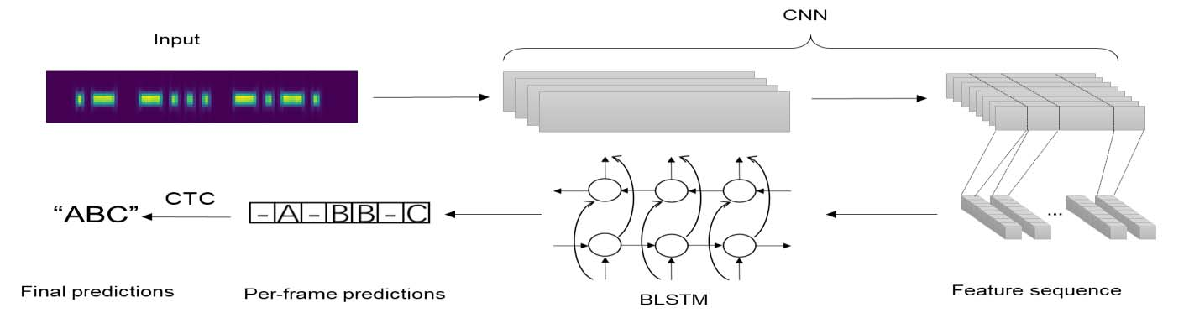
Methodology(Existing Work)

Slide 10
Drawbacks
If the input signals have high frequency (>700HZ), the model will not perform well.
If the length of the input signal is more than 4s the model will unable to identify input signal.
The CTC process is very time consuming to annotate a dataset on character level.
The BLSTM require more memory and take longer time to train.

Slide 11
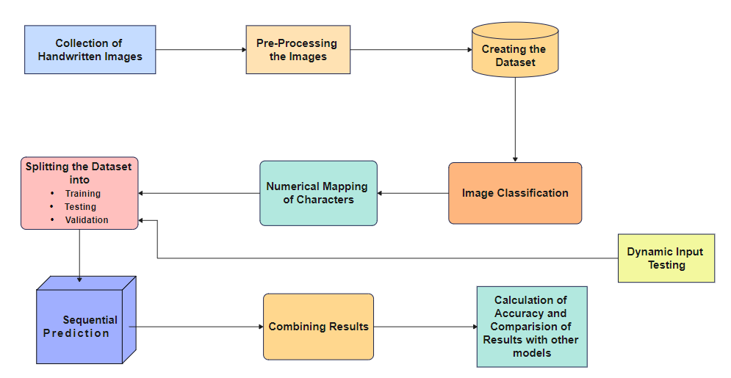
Proposed Technique

Slide 12
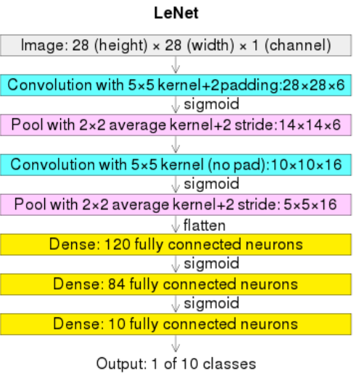
LeNet-5 Model
We have taken a Sequential model
Then we have added Conv2D layer, with an activation function relu.
The activation function relu , does not activate all the neurons and it is used to avoid vanishing gradient problem.
The pooling layers are used to reduce the dimensions of the feature map, and the maxpool is used to get the maximum value of the feature map.
The flatten layer is used to convert all the 2D arrays from pooled feature maps into a single long continuous linear vector.

Slide 13
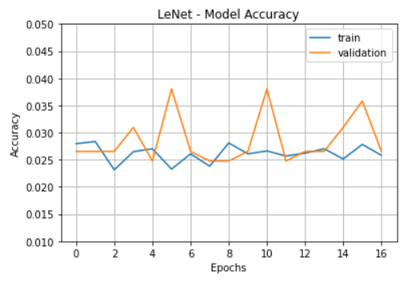
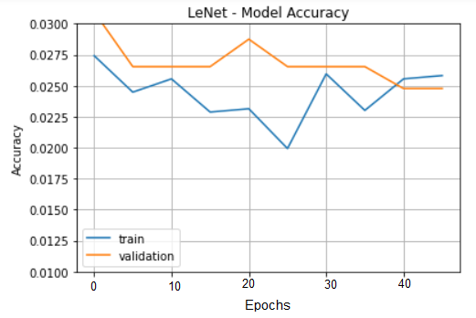
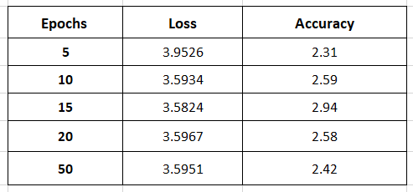

Slide 14
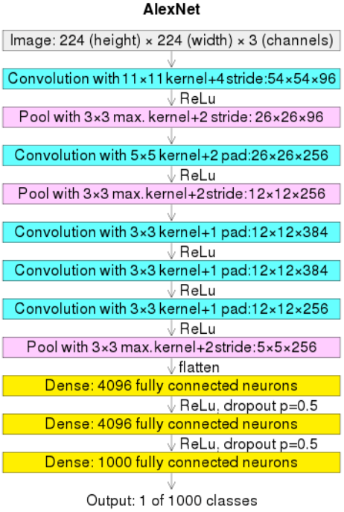
AlexNet Model
Here also we have taken a Sequential model.
In the AlexNet, the Batch Normalization layer is added.
This Batch Normalization layers are used to decrease the epochs, increase the speed and performance of neural networks.
In a Neural Network the optimizers are used to reduce the overall loss and increase the accuracy.
Here we have used Adam optimizer, because Adam optimizers have faster computation time and require fewer parameters for tuning.

Slide 15
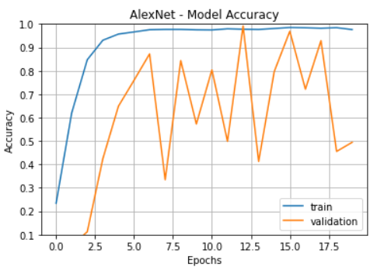
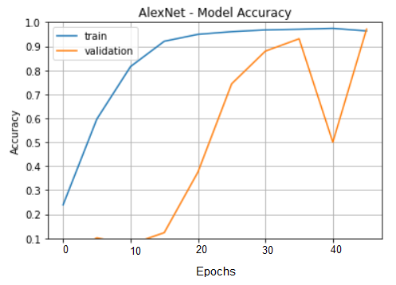
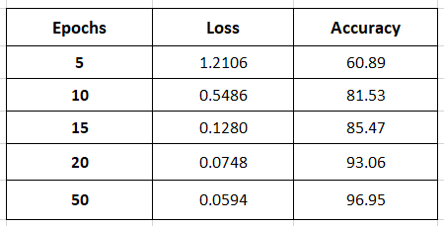

Slide 16
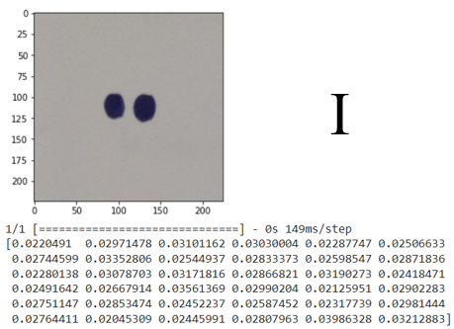
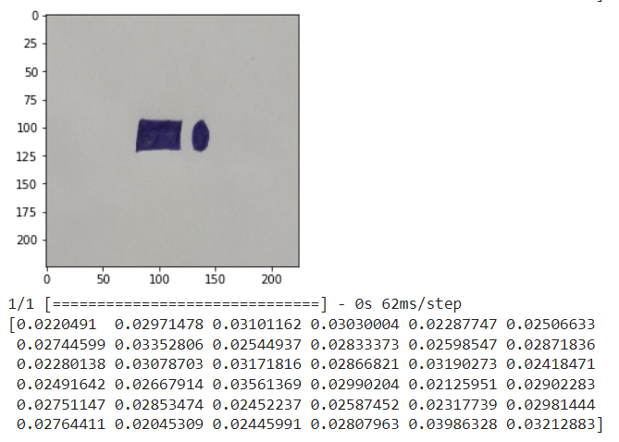
Results
Outputs of LeNet-5 Model
Prediction of Letter : I
Prediction of Letter : N

Slide 17
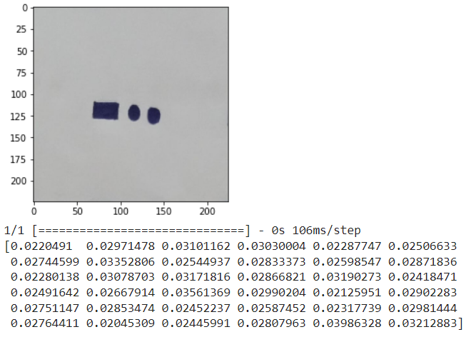
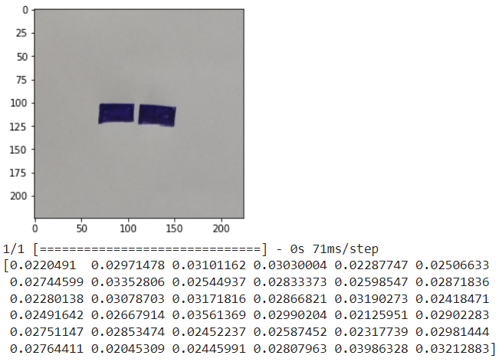
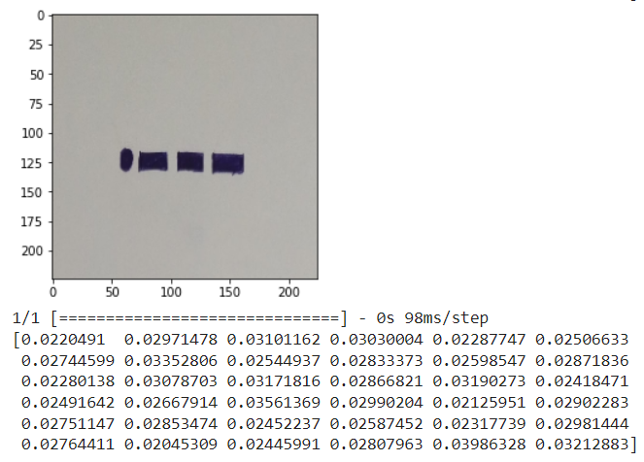
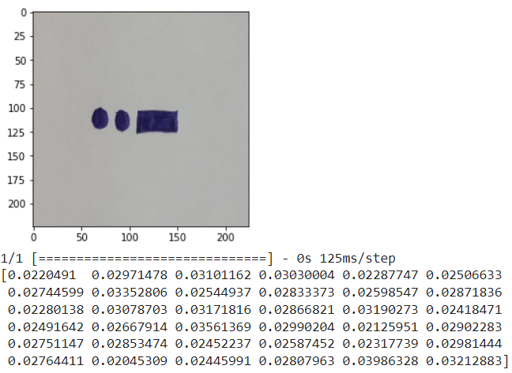
Prediction of Letter : D
Prediction of Letter : M
Prediction of Letter : J
Prediction of Letter : U

Slide 18
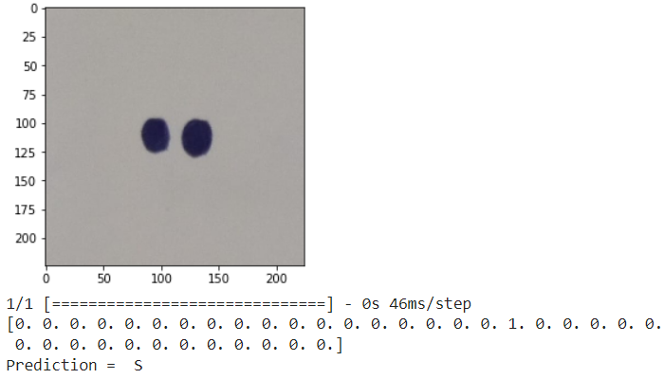
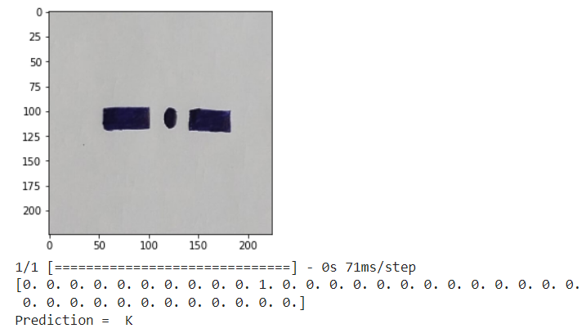
Outputs of AlexNet Model
Prediction of Letter S
Prediction of Letter K

Slide 19
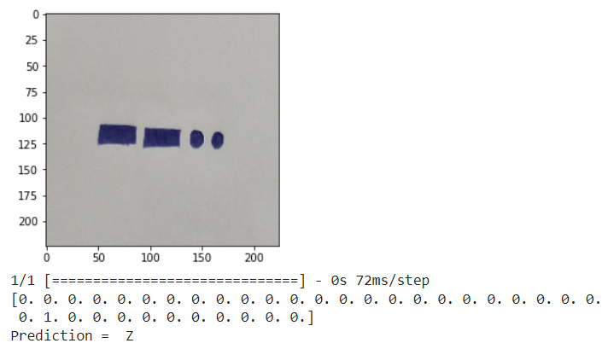
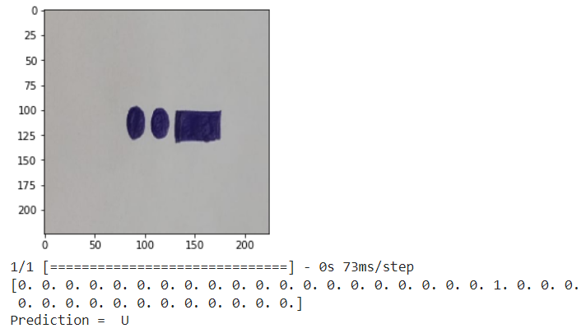
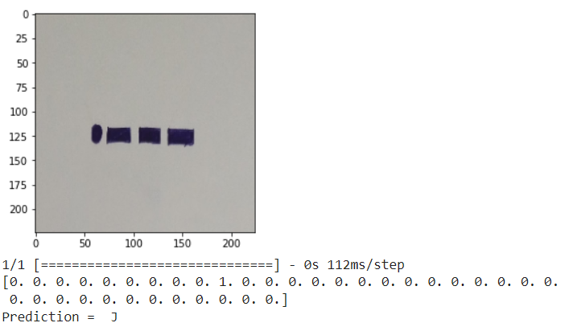
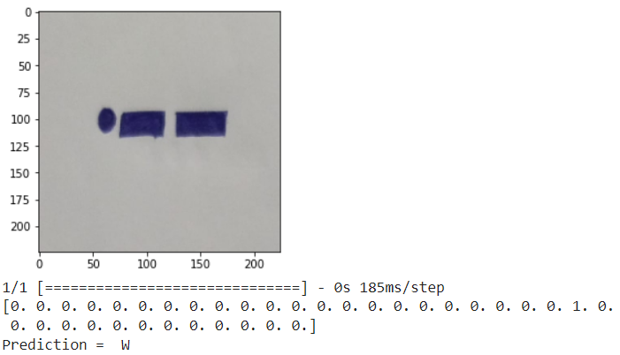
Prediction of Letter Z
Prediction of Letter U
Prediction of Letter J
Prediction of Letter W

Slide 20
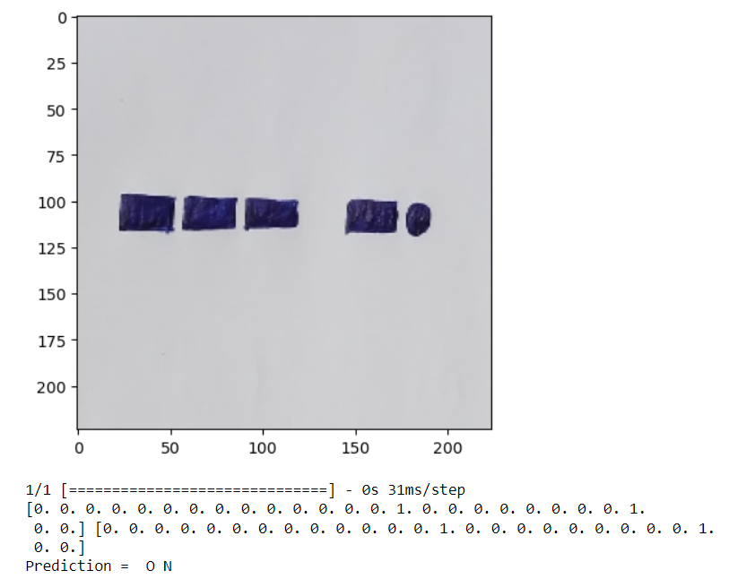
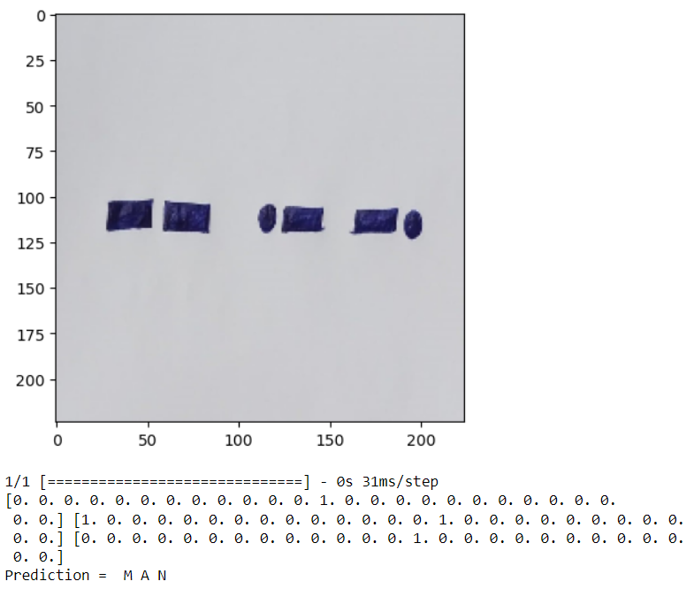
Prediction of Letters : O N
Prediction of Letters : M A N

Slide 21
Future Work
As of now, we have classified individual images of morse code and multiple characters present in a word. In, future we are gonna take multiple sentences of morse code as input, In which each word is separated by ‘/’.
Then we will convert the sentences of morse code into English Text.

Slide 22
Conclusion
The use of Convolutional Neural Networks in detection of text from Morse code in images has shown promising results. We have built a machine learning model, which take morse code images as input, detected the morse code and then convert the morse code into English text with better accuracy.
The accuracy of the model may vary depending on the quality of the images and the complexity of the Morse code patterns. , the use of CNN in text detection from Morse code in images can be a useful tool in various fields, including military and aviation communication, navigation systems, and emergency communication.

Slide 23
References
[1] S. Sudha, S. Mythili and S. S. Balamurugan, "Detection of Text from Morse Code in Images using Convolutional Neural Network," 2021 International Conference on Electronics, Communication, and Aerospace Technology (ICECA), Coimbatore, India, 2021, pp. 1192-1197, doi: 10.1109/ICECA51584.2021.9485803.
[2] R. Girshick, J. Donahue, T. Darrell and J. Malik, "Region-based convolutional networks for accurate object detection and segmentation," IEEE Transactions on Pattern Analysis and Machine Intelligence, vol. 38, no. 1, pp. 142-158, Jan. 2016, doi: 10.1109/TPAMI.2015.2436995.
[3] K. He, X. Zhang, S. Ren and J. Sun, "Deep Residual Learning for Image Recognition," 2016 IEEE Conference on Computer Vision and Pattern Recognition (CVPR), Las Vegas, NV, USA, 2016, pp. 770-778, doi: 10.1109/CVPR.2016.90.
[4] Y. LeCun, L. Bottou, Y. Bengio and P. Haffner, "Gradient-based learning applied to document recognition," Proceedings of the IEEE, vol. 86, no. 11, pp. 2278-2324, Nov. 1998, doi: 10.1109/5.726791.
[5] J. Redmon, S. Divvala, R. Girshick and A. Farhadi, "You Only Look Once: Unified, Real-Time Object Detection," 2016 IEEE Conference on Computer Vision and Pattern Recognition (CVPR), Las Vegas, NV, USA, 2016, pp. 779-788, doi: 10.1109/CVPR.2016.91.
[6] K. Simonyan and A. Zisserman, "Very Deep Convolutional Networks for Large-Scale Image Recognition," 2014 arXiv:1409.1556.

Slide 24
[7] C. Szegedy, W. Liu, Y. Jia, P. Sermanet, S. Reed, D. Anguelov, D. Erhan, V. Vanhoucke and A. Rabinovich, "Going Deeper with Convolutions," 2015 IEEE Conference on Computer Vision and Pattern Recognition (CVPR), Boston, MA, USA, 2015, pp. 1-9, doi: 10.1109/CVPR.2015.7298594.
[8] Y. Taigman, M. Yang, M. Ranzato and L. Wolf, "DeepFace: Closing the Gap to Human-Level Performance in Face Verification," 2014 IEEE Conference on Computer Vision and Pattern Recognition (CVPR), Columbus, OH, USA, 2014, pp. 1701-1708, doi: 10.1109/CVPR.2014.220.
[9] C. Yan, Z. He, H. Wang and X. Liu, "Morse code identification based on convolutional neural network," 2019 IEEE 5th International Conference on Computer and Communications (ICCC), Chengdu, China, 2019, pp. 1531-1535, doi: 10.1109/CompComm49359.2019.8941357.
[10] S. AlMajthoub, H. AlDmour, M. AlKabi and R. Alghazo, "Morse Code Decoder using Deep Learning," 2019 IEEE Jordan International Joint Conference on Electrical Engineering and Information Technology (JEEIT), Amman, Jordan, 2019, pp. 449-454, doi: 10.1109/JEEIT.2019.8717433.
[11] A. M. Abd El-Latif, A. M. Ibrahim and H. A. Hefny, "Morse code recognition using neural networks," 2015 8th International Conference on Human System Interaction (HSI), Warsaw, Poland, 2015, pp. 187-192, doi: 10.1109/HSI.2015.7170695.
[12] X. Chen, H. Jia, Y. Yang, C. Li and H. Wang, "Morse code recognition based on convolutional neural network with improved structure," 2020 IEEE 3rd International Conference on Electronics Technology (ICET), Chengdu, China, 2020, pp. 1432-1436, doi: 10.1109/ICET48890.2020.00025.

Slide 25
THANK YOU

